Slide 1
CHAPTER 4
Mutual Funds and Other Investment Companies

Slide 2
Investment Companies
4-<number>
Pool funds of individual investors and invest in a wide range of securities or other assets.
Services provided:
  Administration & record keeping
  Diversification & divisibility
  Professional management
  Reduced transaction costs

Slide 3
Net Asset Value
4-<number>
Calculation:
Market Value of Assets - Liabilities
Shares Outstanding

Slide 4
Types of Investment Companies
4-<number>
Unit Trusts
  Fixed portfolio of uniform assets
  Unmanaged
  Total assets have declined from $105 billion in 1990 to $29 billion in 2009

Slide 5
Types of Investment Companies
4-<number>
Managed Investment Companies
  Open-End
    Fund issues new shares when investors buy in and redeems shares when investors cash out
    Priced at Net Asset Value (NAV)

Slide 6
Types of Investment Companies
4-<number>
Managed Investment Companies
  Closed-End
    no change in shares outstanding; old investors cash out by selling to new investors
    Priced at premium or discount to NAV

Slide 7
Types of Investment Companies
4-<number>
Other investment organizations
  Commingled funds
  REITs
  Hedge Funds

Slide 8
Mutual Funds: Open-End Investment Companies
4-<number>
Money Market
Equity
Sector
Bond
Balanced
Asset Allocation and Flexible
Index
International

Slide 9
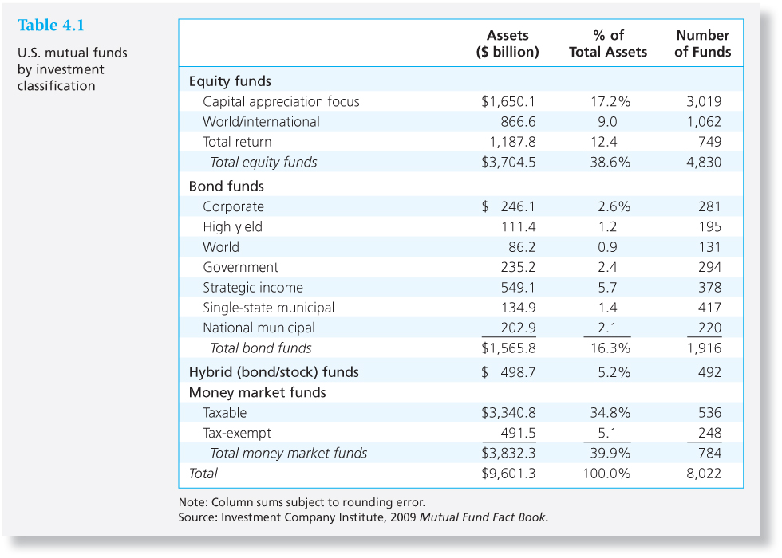
Table 4.1 U.S. Mutual Funds by Investment Classification
4-<number>

Slide 10
How Funds Are Sold
4-<number>
Direct-marketed funds
Sales force distributed
  Revenue sharing on sales force distributed
  Potential conflicts of interest
Financial Supermarkets

Slide 11
Costs of Investing in Mutual Funds
4-<number>
Fee Structure: Four types
  Operating expenses
  Front-end load
  Back-end load
  12 b-1 charge
Fees must be disclosed in the prospectus
Share classes with different fee combinations

Slide 12
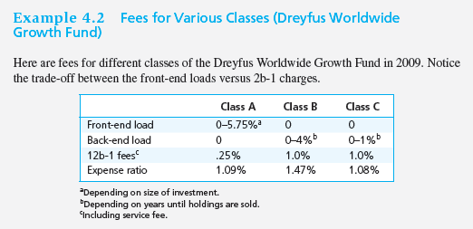
Example 4.2: Fees for Various Classes
(Dreyfus Worldwide Growth Fund)
4-<number>

Slide 13
Fees and Mutual Fund Returns:
An Example
4-<number>
Initial NAV = $20
Income distributions of $.15
Capital gain distributions of $.05
Ending NAV = $20.10:

Slide 14
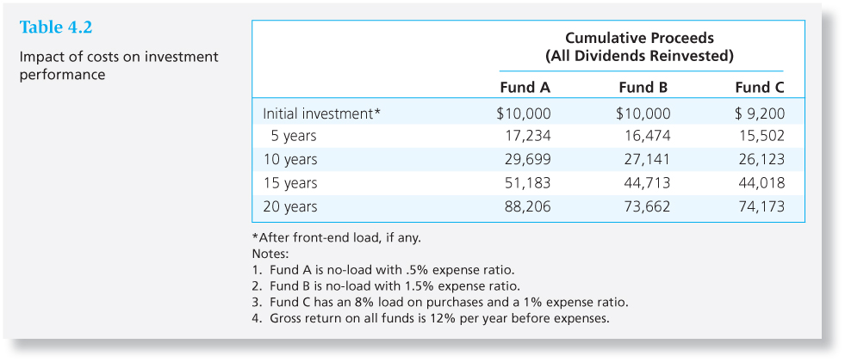
Table 4.2 Impacts of Costs on Investment Performance
4-<number>

Slide 15
Late Trading and Market Timing
4-<number>
Late trading – accepting buy or sell orders after the market closes and NAV is determined
Market timing – rapid in-and-out trading on stale net asset values
Net effect is to transfer value from ordinary shareholders to privileged traders
Mutual funds penalized for improper trading. New rules to prevent these practices

Slide 16
Taxation of Mutual Fund Income
4-<number>
Pass-through status under the U.S. tax code
  Taxes are paid only by the investor
  Fund investors do not control the timing of the sales of securities from the portfolio
High portfolio turnover leads to tax inefficiency
  Average turnover = 60%

Slide 17
Exchange Traded Funds
4-<number>
Examples: “spiders”, “diamonds” and “cubes”
Potential advantages:
  Trade continuously like stocks
  Can be sold short or purchased on margin
  Lower costs
  Tax efficient
Potential disadvantages:
  Prices can depart by small amounts from NAV
  Must be purchased from a broker

Slide 18
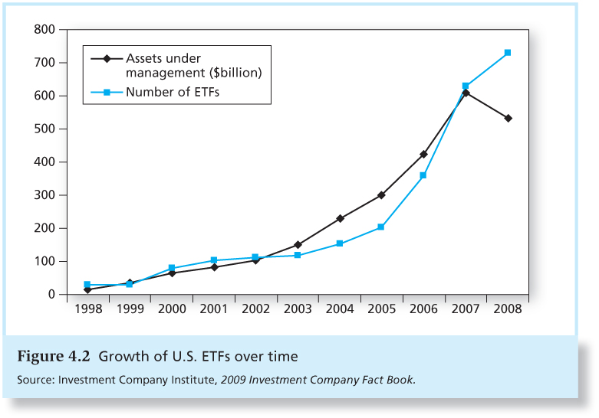
Figure 4.2 Growth of U.S. ETFs over time
4-<number>

Slide 19
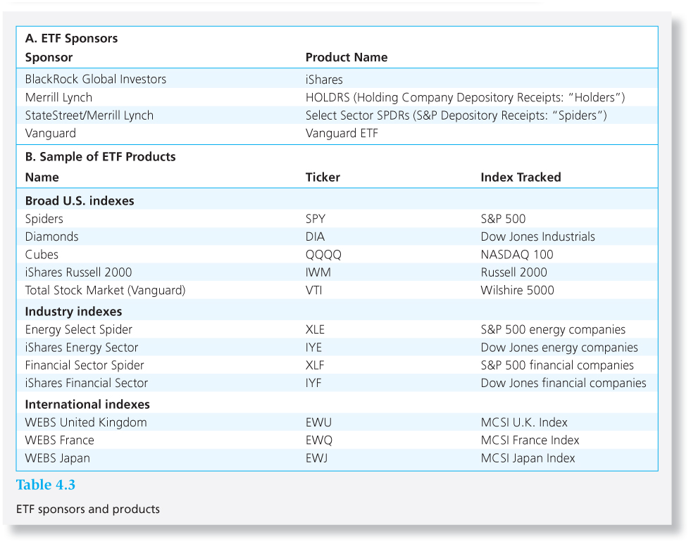
Table 4.3 ETF Sponsors and Products
4-<number>

Slide 20
Mutual Fund Investment Performance:
A First Look
4-<number>
Performance of actively managed funds:
  below the return on the Wilshire index in 23 of the 39 years from 1971 to 2009
  Evidence for persistent superior performance (due to skill and not just good luck) is weak, but suggestive
  Bad performance more likely to persist

Slide 21
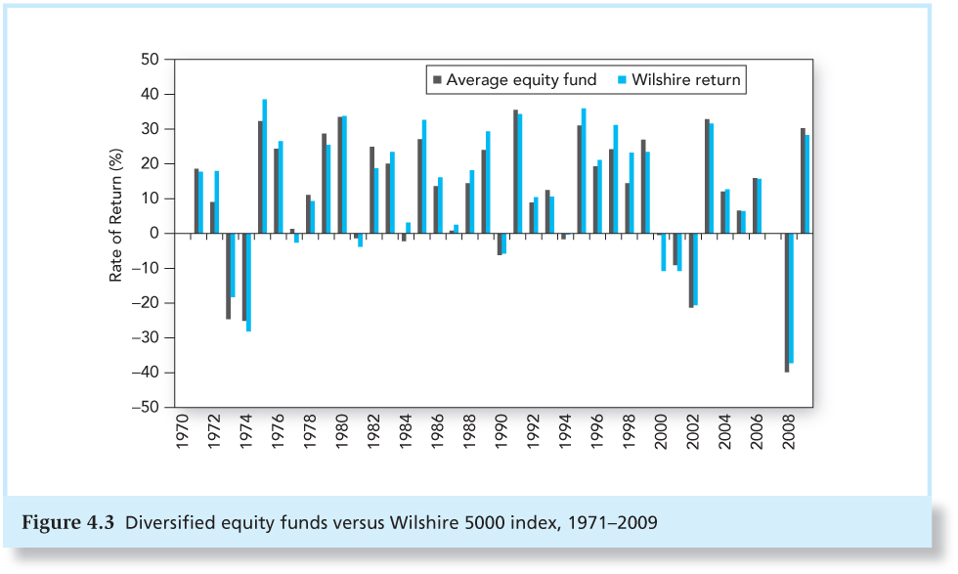
Figure 4.3 Diversified Equity Funds versus Wilshire 5000 Index
4-<number>

Slide 22
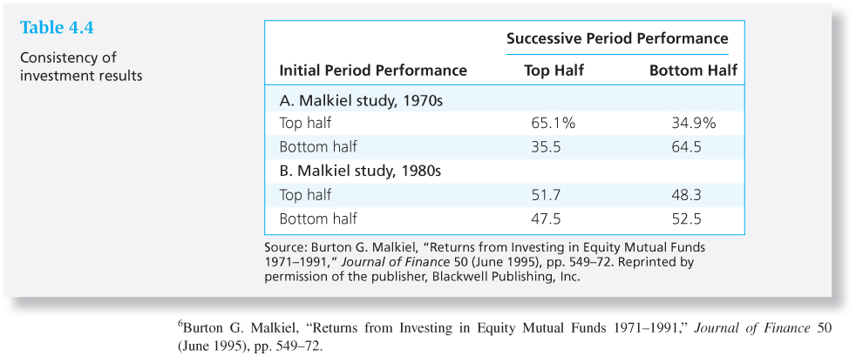
Table 4.4 Consistency of
Investment Results
4-<number>

Slide 23
Information on Mutual Funds
4-<number>
Fund’s prospectus describes:
  investment objectives
  Fund investment adviser and portfolio manager
  Fees and costs
Statement of Additional Information (SAI)
Fund’s annual report

Slide 24
Information on Mutual Funds
4-<number>
Wiesenberger’s Investment Companies
Morningstar (www.morningstar.com)
Yahoo (biz.yahoo.com/funds)
Investment Company Institute (www.ici.org)
Directory of Mutual Funds

Slide 25
Information on Mutual Funds
4-<number>
https://www.youtube.com/watch?v=ngfKXvfzC74 Mutual Fund
https://www.youtube.com/watch?v=kqr-h-pmky4 ETFs
https://www.youtube.com/watch?v=3rFjS2yNjqc Index Funds

